Slide 1






PANIMALAR ENGINEERING COLLEGE
An Autonomous Institution
Affiliated to Anna University, Chennai [ JAISAKTHI EDUCATIONAL TRUST ]
EMPOWER ASSIST
Offline Speech and Gesture-Controlled Smart System for Accessibility and Safety
A1
“Helping You Live Life on Your Own Terms”
SDG 9: Industry, Innovation & Infrastructure
TEAM MEMBERS
GUIDE
Arundhathi T (211421104028)
Kalpana Devi M (211421104117)
Kavya Sri N (2114211040175)
Dr. Kavitha Subramani
PROFESSOR
Professor
M.E., Ph.D

Slide 2



ABSTRACT
-According to a survey done by the World Health Organization (WHO) An estimated 1.3 billion people worldwide—approximately 16% of the global population—experience significant disability. Despite several discussions, the safety and support for individuals with disabilities often remain unresolved.
-To address this critical issue, we propose a system by implementing the concept of IOT, this project aims to provide a comprehensive solution that enhances the quality of life for people with disabilities.

Slide 3

INTRODUCTION
-Just as smartphones revolutionized communication, today, smart systems are transforming the way we interact with our surroundings.
-With the rapid growth of the Internet of Things (IoT), our world is becoming more connected, automated, and accessible.
-From smart homes to assistive technologies, IoT is playing a crucial role in enhancing convenience, safety, and quality of life—especially for those who need it the most.
Our project is an attempt to implement IOT to make the already difficult life of the disabled-people a little easier.
Transforming the way that we live, work, and interact with each other.

Slide 4
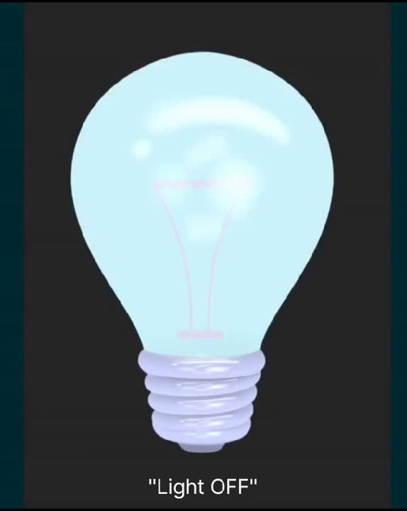


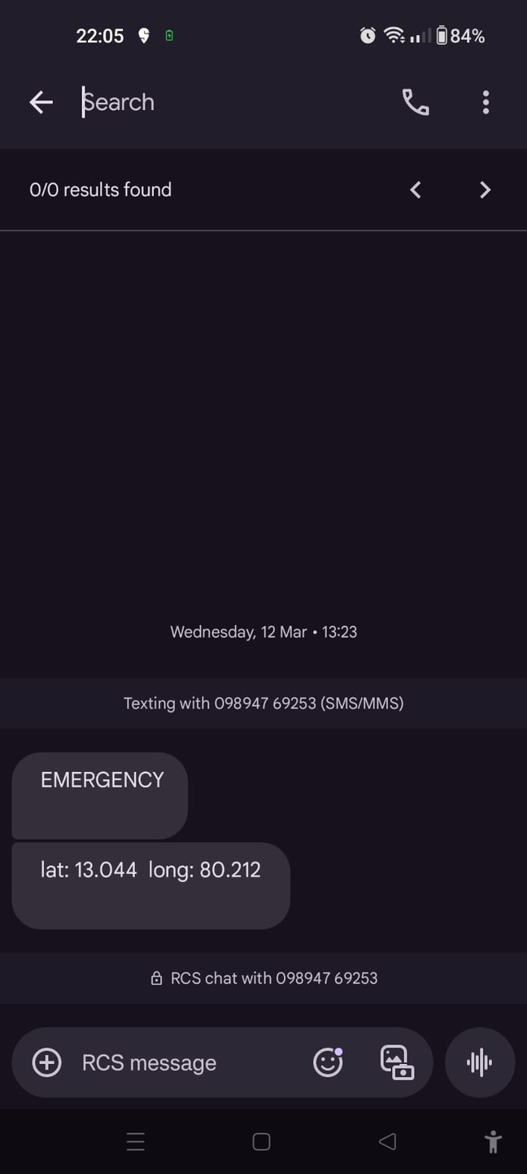
OBJECTIVE
-The objective of this project is to develop a smart system specifically designed for differently-abled individuals enabling users to control their environment using voice commands and hand gestures without requiring an internet connection.
-Additionally, The emergency alert system is implemented to notify a trusted contact in case of assistance by rendering the exact location. The system also keeps track of all the records for future use.

Slide 5

LITERATURE SURVEY

Slide 6

S.NO | YEAR | TITLE | JOURNAL DETAILS | KEY POINTS
1. | 2024 | Smart Home Voice and Gesture Control Integration using Bluetooth and Gesture Sensor | Anwaraly Yasmine Begum and et al., 2024 5th International Conference on Image Processing and Capsule Networks (ICIPCN) | Enhanced user accessibility, real-time monitoring, and remote control of appliances through an intuitive mobile interface.
2. | 2024 | Voice-Activated Assistance for the Elderly: Integrating Speech Recognition and IoT | Narumol Chumuang and et al., 2024 IEEE International Conference on Consumer Electronics (ICCE) | Improved responsiveness, reduced dependency on external software, and enhanced standalone functionality of IoT devices.

Slide 7
S.NO | YEAR | TITLE | JOURNAL DETAILS | KEY POINTS
3. | 2024 | Hand and Face Gesture Recognition for Specially Abled People Communication | Manjesh R and et al., International Journal of Creative Research Thoughts, 2024 (IJCRT) | It gives an accurate, real-time, user-friendly system that enables seamless interaction and expression.
4. | 2023 | Voice Assistant For Physically Challenged Individuals: Enhancing Accessibility And Independence | Shresth Agarwal and et al., International Journal of Engineering Applied Sciences and Technology, 2023 | Enhanced real-time command execution and accessibility through direct speech recognition and immediate action.

Slide 8
S.NO | YEAR | TITLE | JOURNAL DETAILS | KEY POINTS
5. | 2023 | Design, Implementation, and Practical Evaluation of a Voice Recognition Based IoT Home Automation System for Low-Resource Languages and Resource-Constrained Edge IoT Devices: A System for Galician and Mobile Opportunistic Scenarios | Ivan Froiz-Miguez and et al., IEEE Xplore | Efficient, bilingual voice command execution for IoT devices, enhancing accessibility and usability.
6. | 2023 | Home Automation System Using IoT | Ivanshu Patil and et al., International Journal of Creative Research Thoughts, 2023 (IJCRT) | Increased reliability, reduced dependence on internet connectivity, and enhanced privacy for controlling home appliances offline.

Slide 9
S.NO | YEAR | TITLE | JOURNAL DETAILS | KEY POINTS
7. | 2022 | Emergency Alert System for Disabled People using Hand Gestures and GSM | Aswani V and et al., International Journal Of Scientific Research and Development(IJSDR) | Facilitated communication for disabled individuals through gesture-based control, voice output & emergency messaging, enhancing accessibility & safety.
8. | 2022 | Home IO: Offline Smart Home Automation System with Automatic Speech Recognition and Household Power Usage Tracking | I.B.C. Irugalbandara and et al., 2022 IEEE World AI IoT Congress (AIIoT) | Enhanced accessibility and security for disabled users with real-time assistance and protection from cyber threats in offline environments.

Slide 10
S.NO | YEAR | TITLE | JOURNAL DETAILS | KEY POINTS
9. | 2022 | Smart Home Automation for Differently Abled Person using Controller and IoT | Kavitha M and et al., International Journal of Engineering Research & Technology, 2022 (IJERT) | It is an energy-efficient, secure, and remotely accessible smart home automation system.
10. | 2020 | IoT Enabled Gesture-Controlled Home Automation for Disabled and Elderly | Smruti Kshirsagar and et al., 2020 Fourth International Conference on Computing Methodologies and Communication (ICCMC) | It is improved accessibility and convenience for elderly and disabled individuals, enabling them to control household devices effortlessly using hand gestures, while providing caretakers with remote monitoring capabilities via a mobile app.

Slide 11
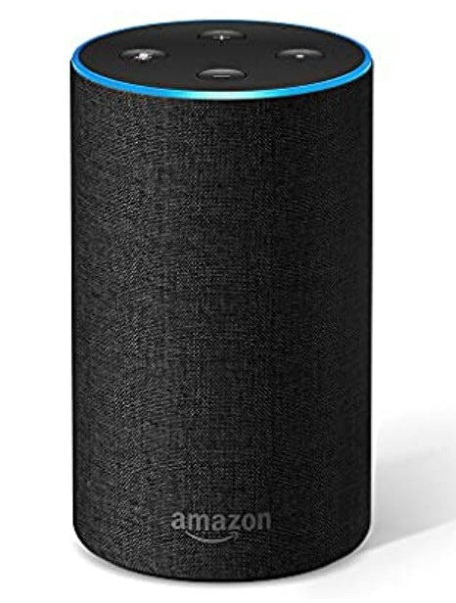
EXISTING SYSTEM
-The existing system is a in multi-user voice-controlled systems, specifically focusing on smart home assistants like Amazon Alexa.
-However these systems face critical issues due to inadequate access control in shared environments and the difficulty of internet connectivity and availability making this system effective only in big cities .

Slide 12





PROBLEM STATEMENT
Do I always need to be taken care of by someone !?
-Walking sticks for the visually impaired,
Sign language recognition systems for the speech impaired, and Speech-to-text translation software for the hearing impaired have undoubtedly proven to be useful!
-However, these innovations rely on INTERNET that often reduces the effectiveness of such solutions in real-world scenarios.
You are not alone in this :)

Slide 13


PROPOSED SYSTEM
is it so hard
to find a solution without INTERNET!?
GUESS NOT!
-The proposed system is an IOT based solution that helps the users control their environment without INTERNET, through voice commands and gestures.
-In addition to this, the system integrates a assistive system to aid the disabled person in-case of emergency by sending a SMS with the exact location to the trusted contact.
-The system benefits differently-abled individuals, providing the best needed support to navigate through times of difficulty.

Slide 14
NOVELTY
1
2
3
The system is user-specific and supports multiple languages, ensuring accessibility for users speaking different languages
Operates without internet connectivity, making it ideal for use in rural and remote areas, including regions with no network coverage.
This feature immediately sends alert messages to the user’s trusted contacts during critical situations.

Slide 15
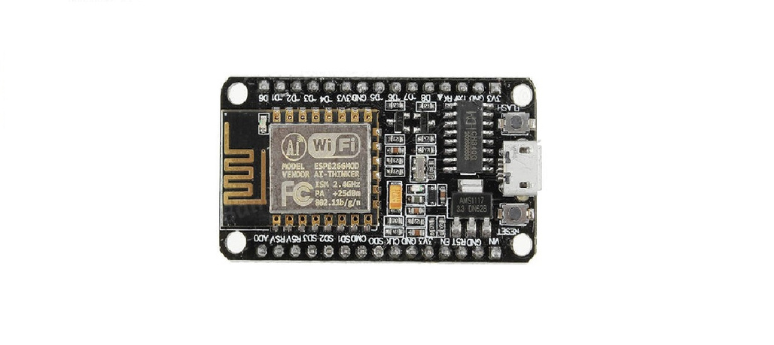
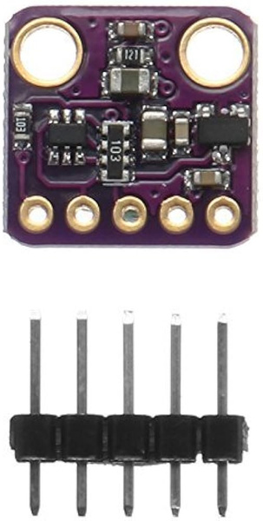
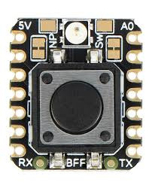
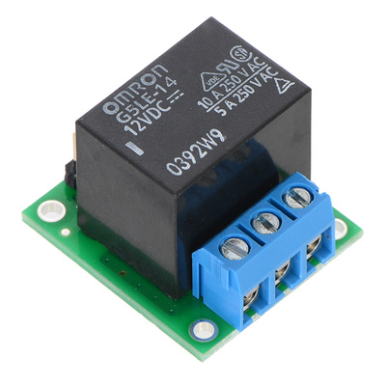
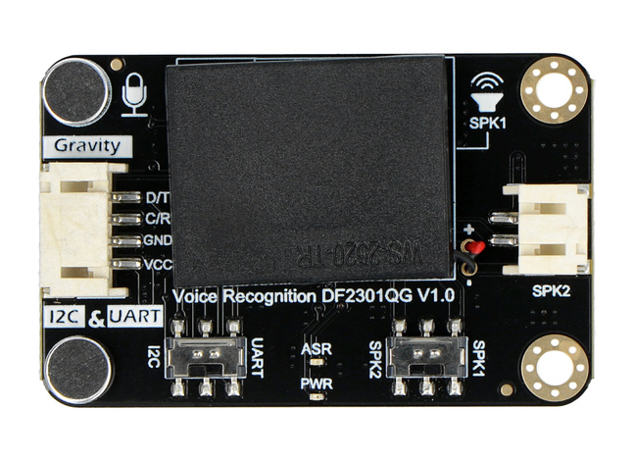

HARDWARE COMPONENTS
NodeMCU
Gesture Module
Button
Relay
Voice recognition module
Bulb

Slide 16


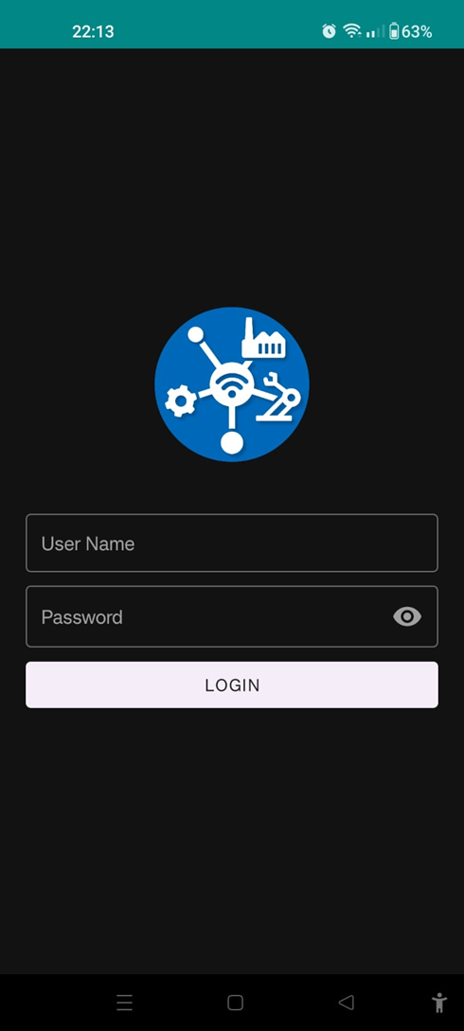
SOFTWARE COMPONENTS
Arduino IDE
MS Excel
IOT App

Slide 17
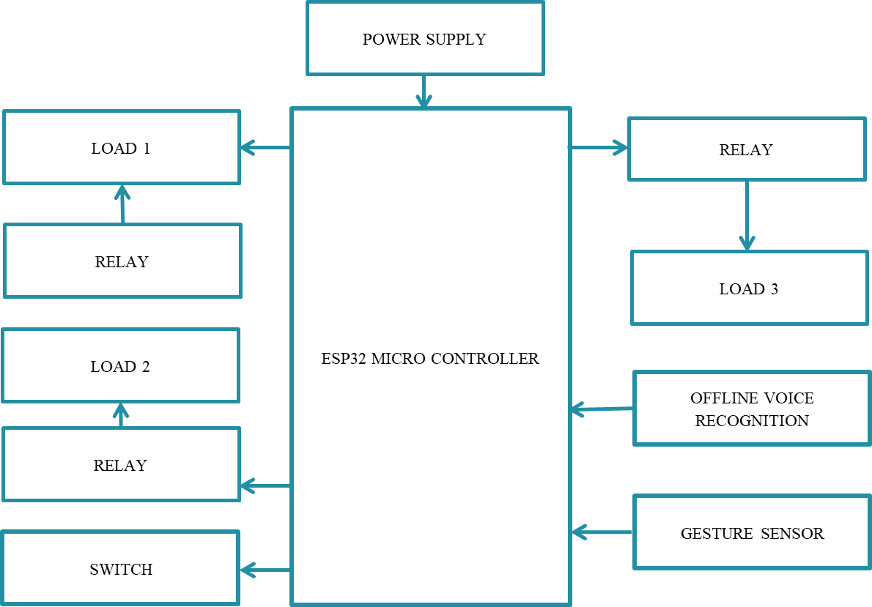
ARCHITECTURE
The architecture consists of 2 micro-controllers in order to control the assistive system and home automation.
A GSM Module to fetch exact location of the disabled person.
A LCD to intimate the message as been sent to the trusted contact.
A DC fan and Light to demonstrate the functionality of the proposed system.
An Arduino microcontroller to support offline speech recognition and Gesture sensor.
Lastly, Relay board to restrict the connections from short-circuiting.

Slide 18
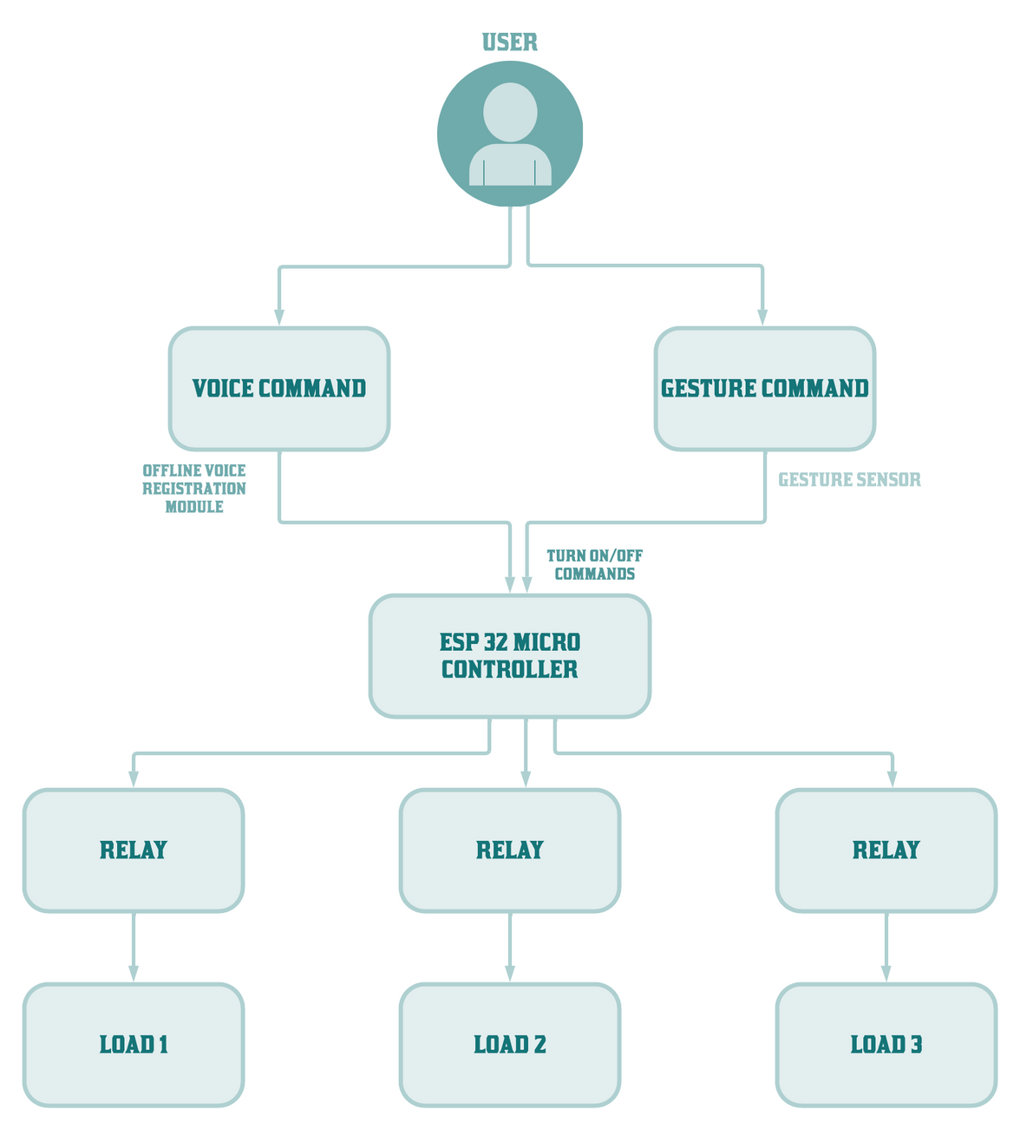
FLOW CHART

Slide 19
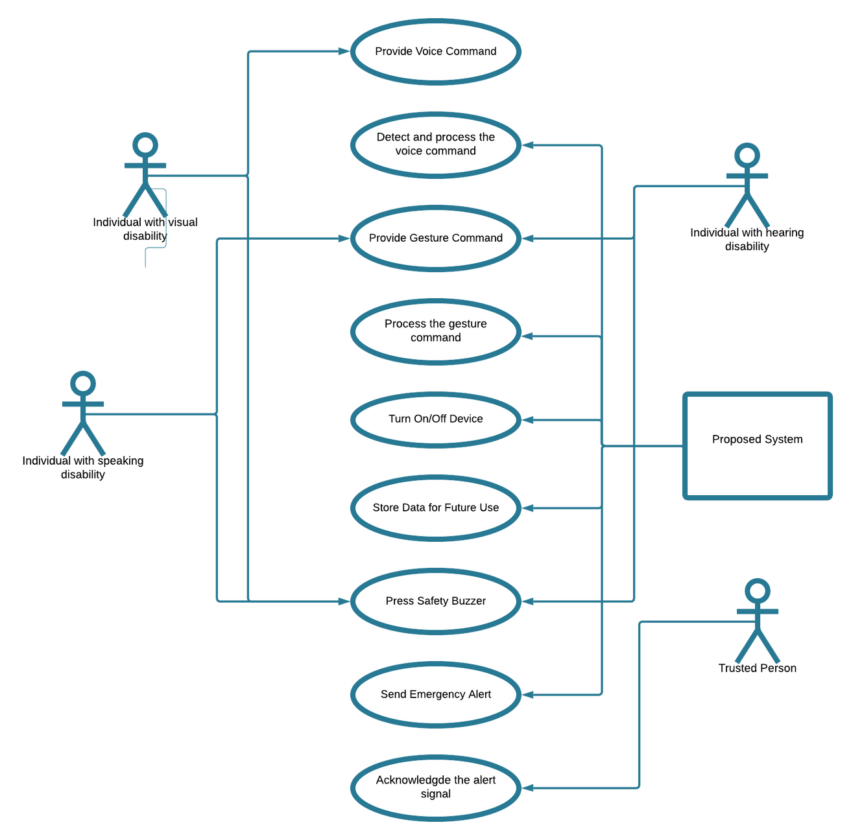
USE CASE

Slide 20

RESULTS
Users are given a personal login to access the records either on the phone/ website

Slide 21
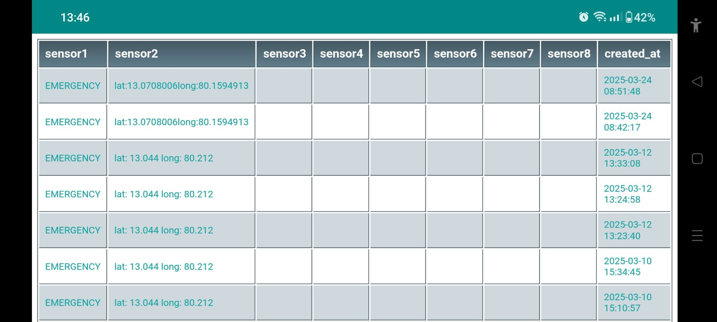
APP OUTPUT

Slide 22
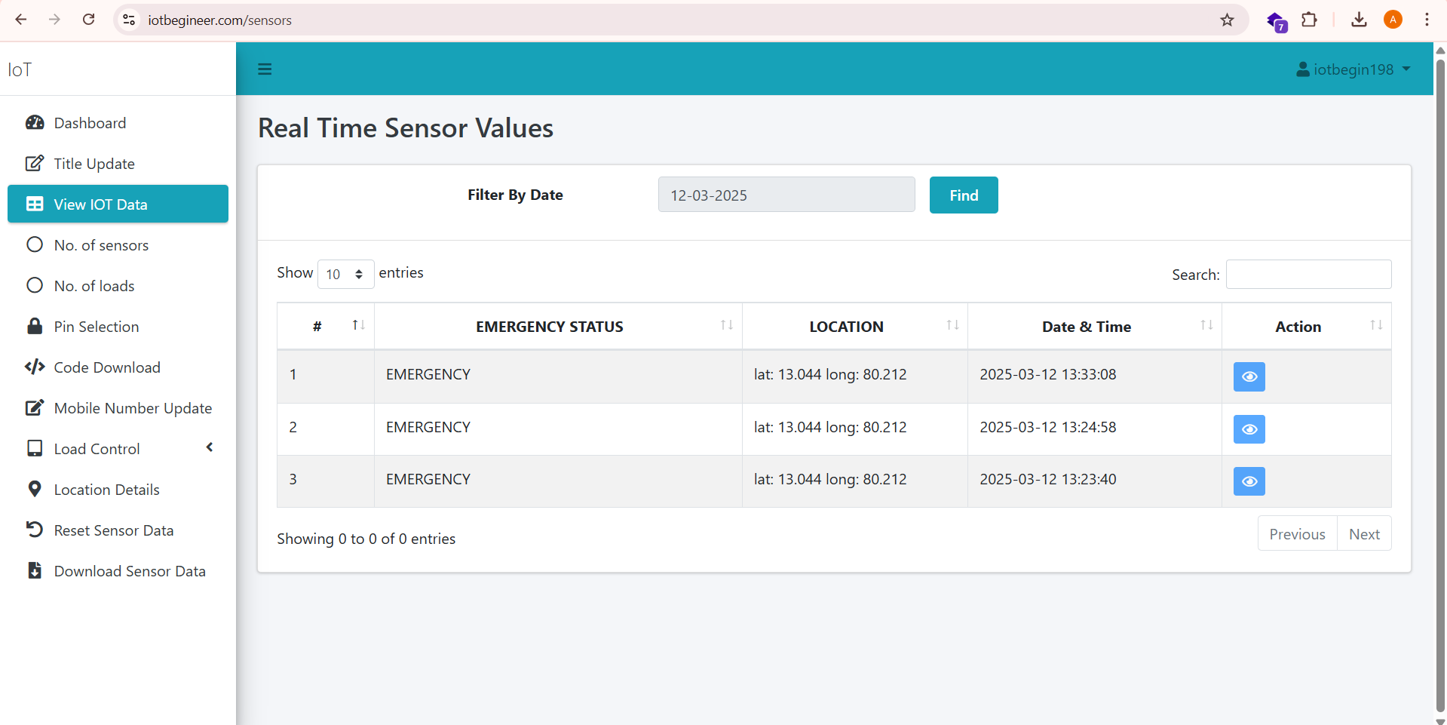
WEBSITE OUTPUT

Slide 23
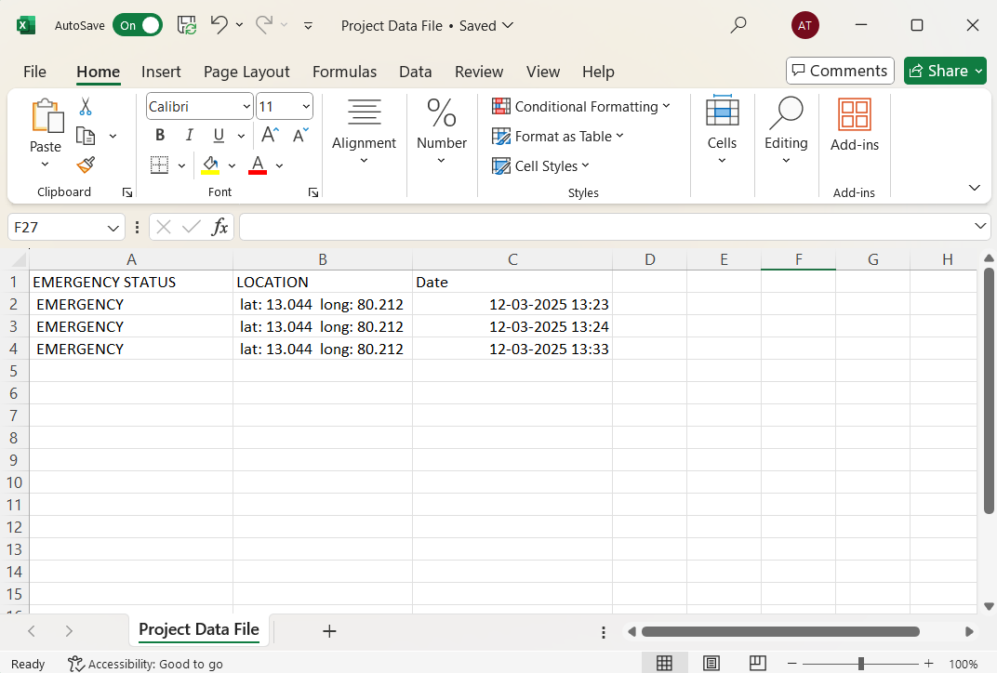
EXCEL FILE
The records can be extracted as an excel file for future references

Slide 24
CONCLUSION
To sum up, this project effectively illustrates a complete offline enabled-home automation system designed to improve the disabled people’s standard of living. The proposed system ensures accessibility and convenience without depending on internet connectivity by combining voice recognition and gesture-based controls to provide an easy-to-use interface for controlling household appliances.

Slide 25
FUTURE SCOPE
-In the future, we plan on integrating a battery-powered, portable model to make the system usable in outdoor environments or for individuals on the move. This will enhance accessibility beyond home automation, supporting users in workplaces, hospitals, and public spaces.
-Implementing a hybrid IoT-based system that offers both offline functionality and optional internet connectivity can further expand its capabilities, allowing users to remotely control appliances through mobile applications while maintaining privacy and security.

Slide 26

CONFERENCE
TITLE:
Offline Speech and Gesture Controlled Smart System For Accessibility and Safety
SUBMISSION ID:
ICAMMAIA_2025_055
AUTHORS:
Kavitha Subramani, Kalpana Devi M, Kavya Sri N, Arundhathi T
CONFERENCE DATE:
April 5, 2025 (Online)

Slide 27
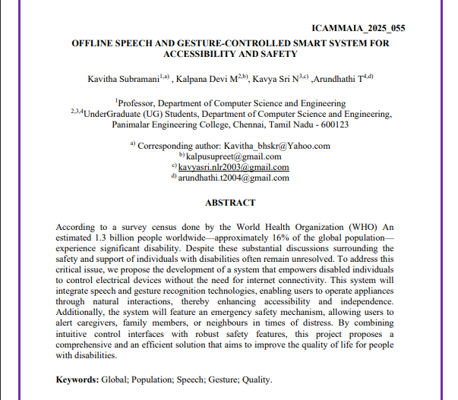

Slide 28
REFERENCES

Slide 29
[1] M. Periša, P. Teskera, I. Cvitić, and I. Grgurević, "Empowering people with disabilities in smart homes using predictive informing," MDPI Open Access Journal, Jan 2025.
[2] Y. B. Anwaraly, G. C. Chowdary, R. M. Umesh, S. Afroz, and S. S. Madhur, "Smart home voice and gesture control integration using Bluetooth and gesture sensor," 2024 5th International Conference on Image Processing and Capsule Networks (ICIPCN), Pune, India, Jul. 2024.
[3] N. Chumuang, T. Ganokratanaa, P. Pramkeaw, M. Ketcham, S. Chomchaiya, and W. Yimyam, "Voice-activated assistance for the elderly: Integrating speech recognition and IoT," 2024 IEEE International Conference on Consumer Electronics (ICCE), Las Vegas, NV, USA, Jan. 2024.
[4] R. Manjesh, M. B. Chethana, C. Priya, and C. Sahana, "Hand and face gesture recognition for specially abled people communication," International Journal of Creative Research Thoughts (IJCRT), May 2024.
[5] S. A. Lohar, P. R. Bagane, S. S. Hervade, S. S. Farakate, and S. S. Phadtare, "Smart alert system for visually impaired person," International Research Journal of Modernization in Engineering Technology and Science, Oct. 2024.

Slide 30
[6] T. Bergur. Smart home statistics. Accessed on: Oct. 2023.
[Online]. Available: https://www.statista.com/topics/2430/smart-homes/
[7] J. Koetsier, ‘‘Amazon echo, google home installed base hits 50 million;
apple has 6% market share, report says,’’ Forbes https://www. forbes.com/sites /johnkoetsier /2018/08 /02/amazon-echo-google-home-installed-base-hits-50-million- apple-has- 6-market-share-report-says, 2018.
[8] Google. Google home product page. Accessed on: Sep. 2023. [Online].
Available: https://store.google.com/product/google_home
[9] Amazon. Alexa store. Accessed on: Jul. 2023. [Online]. Available: https://www.amazon.com /alexa-skills
[10] E. Schwartz. Alexa-enabled device sales pass 500m as amazon unveils new and upgraded echo devices. Accessed on: May 17, 2023. [Online]. Available: https://voicebot.ai/2023/05/17/
[11] A.VidhyashriI, C. Swathi, 2020, Home Automation System Using Li-Fi Technology, International Journal of Recent Technology And Engineering (IJRTE), March 2020.

Slide 31
[12] Aswatha. R, Dharani. C, Keerthana. N, 2018, home automation using light fidelity technique, International Research Journal of Engineering and Technology (IRJET) March 2018.
[13]Isbat Ahmed, Mohammad Shakhawat Hossain, and Tanvir Ahmed Khan, 2018, Smart Home Based on Li-Fi Technology, International Workshop in Information and Communication Technologies (IWITC), May 2018.
[14]R. Puviarasi, Mritha Ramalingam, Elanchezhian Chinnavan, 2014, Self-assistive technology for disabled people voice controlled wheelchair and home automation system, International journal of robotics and automation, March 2014.
[15]Aqeel-ur-Rehman, Royda Arif, Hira Khursheed, 2014, Voice-controlled home automation system for the elderly or disabled people, Journal of applied environmental and biological sciences, Sept 2014.
[16] Perumala achyuth, J Ganesh, Bariki Jagannatha, Ediga Lakkamsani ,Dharma teja goud, Dr B Mahesh. “Hand Gesture Recognition and Voice Conversion for Deaf and Dumb”. Journal of Engineering Sciences-2023.

Slide 32
[17] Abdallah Abualkishik, Wael Alzyadat, Marwan Al Share, Sara Al-Khaifi, Mojtaba Nazari. “Intelligent Gesture Recognition System for Deaf People by using CNN and IoT”. Al-Zaytoonah University of Jordan (ZUJ) -March 2023.
[18] Omar T, Abdulaziz A (2019) Design and Implementation of a multifunction home automation system based on internet of things(IoT). J Comput Sci IJCSIS 17(2).
[19] Suncica M, Sandra I, Tatjana E, Marija A, Nikola S (2017) Implementation of voice control interface for smart home automation system in consumer electronics - Berlin (ICCE-Berlin). In: IEEE 7th international conference, 3–6 September.
[20] Mekuria DN, Sernani P, Falcionelli N, Dragoni AF (2019) Smart home reasoning systems: a systematic literature review. J Ambient Intell Hum Comput pp 1–18.
[21] AbdulGhafar A, Mostafa SM, Alsaleh A, Sheltami T, Shakshuki EM (2020) Internet of things based multiple disease monitoring and health improvement system.
[22] PRAVEEN and PRASAD, "International Journal of Innovative Research in Computer and Communication engineering,"Electronic Voice to Deaf & Dumb People Using Flex Sensor, 2016.
[23] JAIN, SHARMA AND CHAUHAN, "International Journal Of Engineering Science & Research," Image Processing Based Speaking System For Mute People Using Hand Gestures, 2018.

Slide 33
[24] Mittal, Yash, Paridhi Toshniwal, Sonal Sharma, Deepika Singhal, Ruchi Gupta, and Vinay Kumar Mittal. "A voice-controlled multifunctional Smart Home Automation System." In 2015 Annual IEEE India Conference (INDICON), pp. 1-6. IEEE, 2015.
[25] S. Gunputh, A. P. Murdan and V. Oree, "Design and implementation of a low-cost Arduino-based smart home system," 2017 IEEE 9th International Conference on Communication Software and Networks (ICCSN), Guangzhou, 2017, pp. 1491-1495.

Slide 34

Thank
YOU

